Slide 1
Chapter 5: Implementing Intrusion Prevention
CCNA Security v2.0

Slide 2
Chapter Outline
5.0 Introduction
5.1 IPS Technologies
5.2 IPS Signatures
5.3 Implement IPS
5.4 Summary

Slide 3
Section 5.1: IPS Technologies
Upon completion of this section, you should be able to:
Explain zero-day attacks.
Understand how to monitor, detect and stop attacks.
Describe the advantages and disadvantages of IDS and IPS.

Slide 4
Topic 5.1.1: IDS and IPS Characteristics

Slide 5
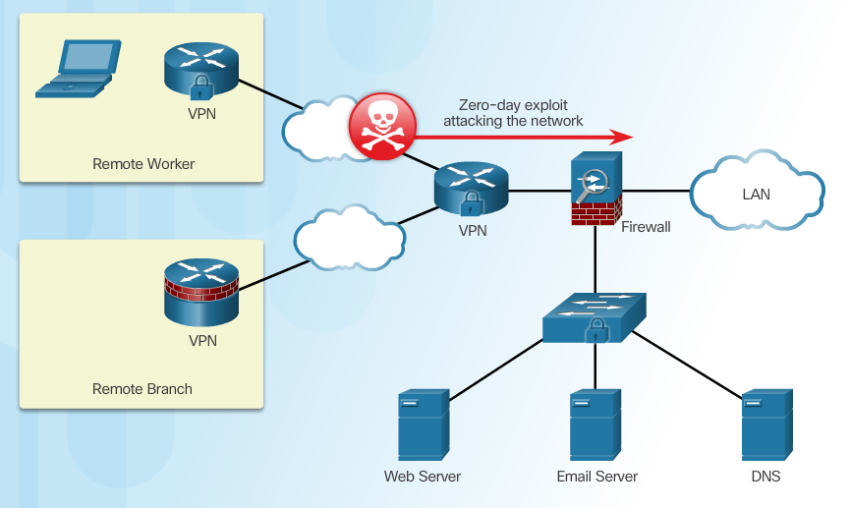
Zero-Day Attacks
A zero-day attack, sometimes referred to as a zero-day threat, is a computer attack that tries to exploit software vulnerabilities that are unknown or undisclosed by the software vendor, as shown in Figure 1. The term zero-hour describes the moment when the exploit is discovered.
Notes:
5.1.1.1 Zero Day Attacks

Slide 6
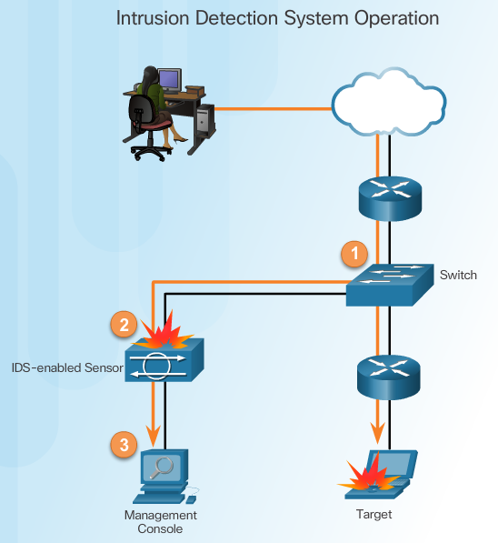
Monitor for Attacks
One approach to prevent worms and viruses from entering a network is for an administrator to continuously monitor the network and analyze the log files generated by the network devices. This solution is not very scalable. Manually analyzing log file information is a time-consuming task and provides a limited view of the attacks being launched against a network. By the time the logs are analyzed, the attack may have already been successful.
Advantages of an IDS:
Works passively
Requires traffic to be mirrored in order to reach it
Network traffic does not pass through the IDS unless it is mirrored
Notes:
5.1.1.2 Monitor for Attacks

Slide 7
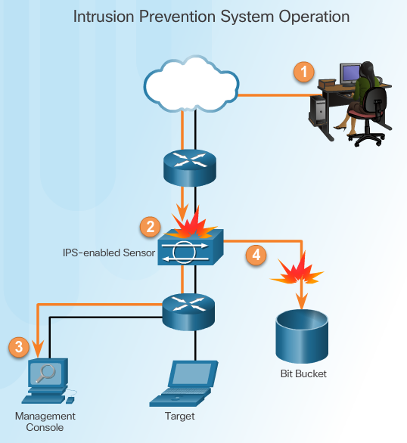
Detect and Stop Attacks
An IPS builds upon IDS technology. However, an IPS device is implemented in inline mode. This means that all ingress and egress traffic must flow through it for processing. As shown in the figure, an IPS does not allow packets to enter the trusted side of the network without first being analyzed. It can detect and immediately address a network problem.
IPS:
Implemented in an inline mode
Monitors Layer 3 and Layer 4 traffic
Can stop single packet attacks from reaching target
Responds immediately, not allowing any malicious traffic to pass
Notes:
5.1.1.3 Detect and Stop Attacks

Slide 8
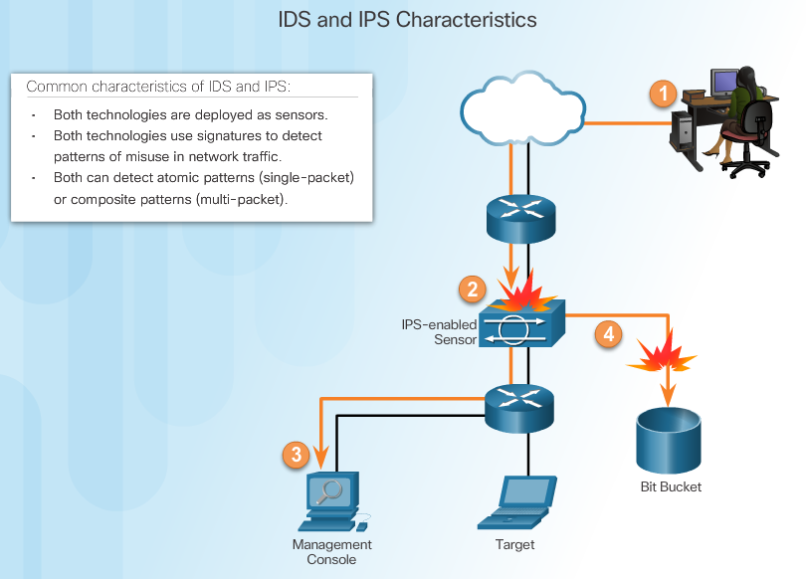
Similarities Between IDS and IPS
Notes:
5.1.1.4 Similarities Between IDS and IPS

Slide 9
Advantages and Disadvantages of IDS and IPS
Advantages IDS:
No impact on network
No network impact if there is a sensor failure
No network impact if there is a sensor overload
Advantages IPS:
Stops trigger packets
Can use stream normalization techniques
Stream normalization is a technique used to reconstruct the data stream when the attack occurs over multiple data segments.
Disadvantages IDS:
Response action cannot stop trigger
Correct tuning required for response actions
More vulnerable to network security evasion techniques
Disadvantages IPS:
Sensor issues might affect network traffic
Sensor overloading impacts the network
Some impact on network
Notes:
5.1.1.5 Advantages and Disadvantages of IDS and IPS
A normalizer is an inline network element that thwarts evasion attempts by removing ambiguities in network traffic. A particularly challenging step in normalization is the sound detection of inconsistent TCP retransmissions, wherein an attacker sends TCP segments with different payloads for the same sequence number space to present a network monitor with ambiguous analysis. Normalizers that buffer all unacknowledged data to verify the consistency of subsequent retransmissions consume inordinate amounts of memory on high-speed links.

Slide 10
Topic 5.1.2: Network-Based IPS Implementations

Slide 11
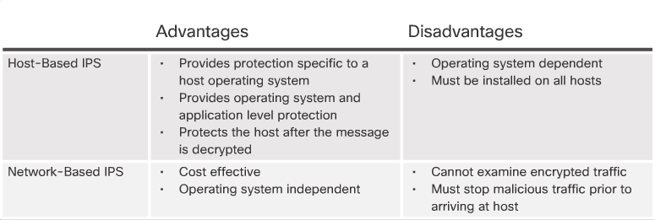
Host-Based and Network-Based IPS
There are two primary kinds of IPSs available: host-based and network-based.
Notes:
5.1.2.1 Host-Based and Network-Based IPS

Slide 12
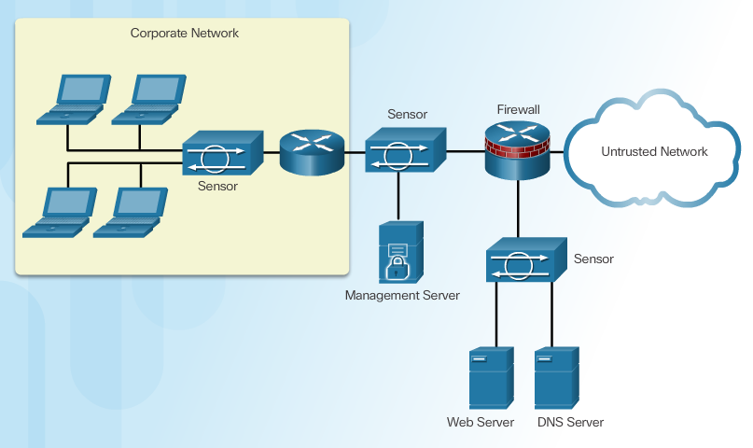
Network-Based IPS Sensors
Notes:
5.1.2.2 Network-Based IPS Sensors

Slide 13
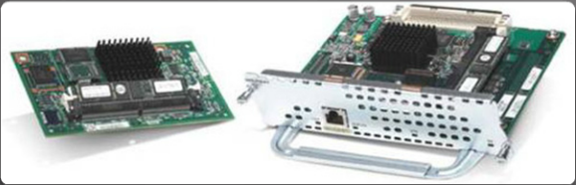
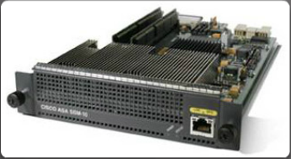
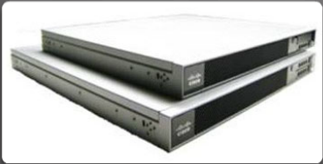
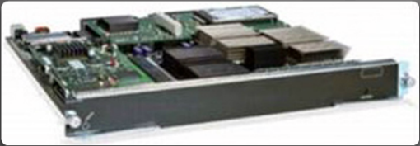
Cisco’s Modular and Appliance-Based IPS Solutions
Cisco IPS AIM and Network Module Enhanced (IPS NME)
On an ISR router
Cisco ASA AIP-SSM
Advanced Inspection and Prevention Security Services Module (AIP-SSM)
Cisco IPS 4300 Series Sensors
As a standalone device, such as a Cisco IPS 4300 Series Sensor
Cisco Catalyst 6500 Series IDSM-2
Added to a Catalyst 6500 switch using an Intrusion Detection System Services Module (IDSM-2)
Notes:
5.1.2.3 Cisco’s Modular and Appliance-Based IPS Solutions, Figures 1 - 4
5.1.2.4 Cisco’s Modular and Appliance-Based IPS Solutions (Cont.)

Slide 14
Choose an IPS Solution
Factors affecting the IPS sensor selection and deployment:
Amount of network traffic
Network topology
Security budget
Available security staff to manage IPS
Small implementations such as branch offices might only require a Cisco IOS IPS-enabled ISR router. As traffic patterns increase, the ISR can be configured to offload IPS functions using an IPS NME or IPS AIM.
Larger installations can be deployed using an existing ASA 5500-X appliance.
Enterprises and service providers might require a dedicated IPS appliance or a Catalyst 6500 using an IDSM-2 network module.
Notes:
5.1.2.5 Choose an IPS Solution

Slide 15
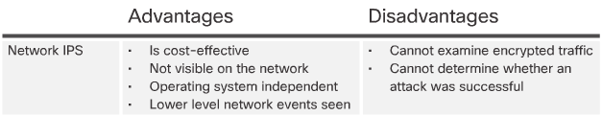
IPS Advantages and Disadvantages
Notes:
5.1.2.6 IPS Advantages and Disadvantages

Slide 16
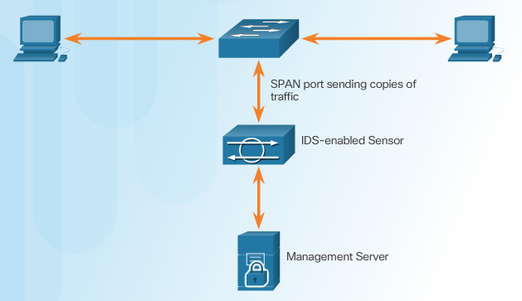

Modes of Deployment
Cisco IDS and IPS sensors can operate in inline mode (also known as inline interface pair mode) or promiscuous mode (also known as passive mode).
Promiscuous Mode
Inline Mode
Notes:
5.1.2.7 Modes of Deployment

Slide 17
Topic 5.1.3: Cisco Switched Port Analyzer

Slide 18
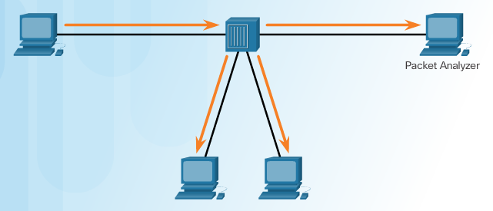
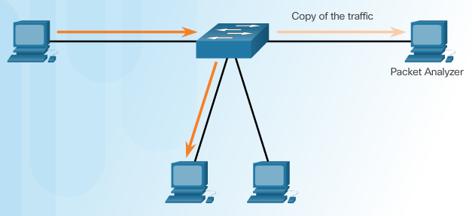
Port Mirroring
Traffic Sniffing Using a Hub
Traffic Sniffing Using a Switch
Notes:
5.1.3.1 Port Mirroring

Slide 19
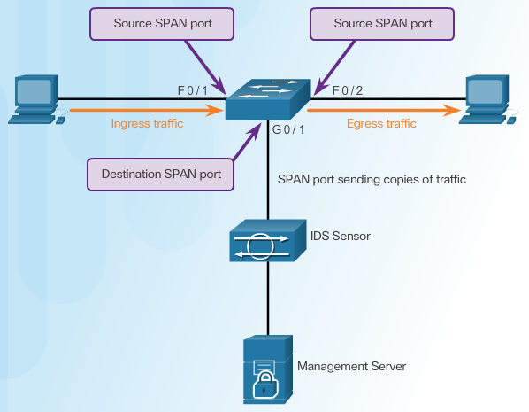
Cisco SPAN
Notes:
5.1.3.2 Cisco SPAN

Slide 20


Configuring Cisco SPAN Using Intrusion Detection
Cisco SPAN Commands:
Monitor session command – used to associate a source port and a destination port with a SPAN session.
Show monitor command – used to verify the SPAN session.
Notes:
5.1.3.3 Configuring Cisco SPAN Using Intrusion Detection

Slide 21
Section 5.2: IPS Signatures
Upon completion of the section, you should be able to:
Understand IPS signature characteristics
Explain IPS signature alarms
Manage and monitor IPS
Understand the global correlation of Cisco IPS devices

Slide 22
Topic 5.2.1: IPS Signature Characteristics

Slide 23
Signature Attributes
A signature is a set of rules that an IDS and an IPS use to detect typical intrusion activity.
Signatures have three distinct attributes:
Type
Trigger (alarm)
Action
Notes:
5.2.1.1 Signature Attributes

Slide 24
Signature Types
Signatures are categorized as either:
Atomic – this simplest type of signature consists of a single packet, activity, or event that is examined to determine if it matches a configured signature. If yes, an alarm is triggered and a signature action is performed.
Composite – this type of signature identifies a sequence of operations distributed across multiple hosts over an arbitrary period of time.
For example, a LAND attack has an atomic signature because it sends a spoofed TCP SYN packet (connection initiation) with the same source and destination IP address of the target host and the same source and destination port as an open port on the target, as shown in the figure. The reason a LAND attack works is because it causes the machine to reply to itself continuously.
Notes:
5.2.1.2 Signature Types

Slide 25
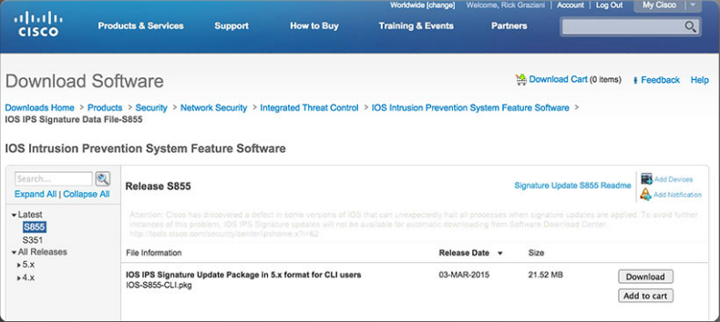
Signature File
As new threats are identified, new signatures must be created and uploaded to an IPS.
A signature file contains a package of network signatures.
Notes:
5.2.1.3 Signature File

Slide 26
Signature Micro-Engines
Cisco IOS defines five micro-engines:
Atomic – Signatures that examine simple packets.
Service – Signatures that examine the many services that are attacked.
String - Signatures that use regular expression-based patterns to detect intrusions.
Multi-string – Supports flexible pattern matching and Trend Labs signatures.
Other – Internal engine that handles miscellaneous signatures.
To make the scanning of signatures more efficient, Cisco IOS software relies on signature micro-engines (SMEs), which categorize common signatures in groups. Cisco IOS software can then scan for multiple signatures based on group characteristics, instead of one at a time.
Notes:
5.2.1.4 Signature Micro-Engines

Slide 27
Download a Signature File
Notes:
5.2.1.5 Acquire the Signature File
5.2.1.6 Activity – Identify IPS Signature Type

Slide 28
Topic 5.2.2: IPS Signature Alarms

Slide 29
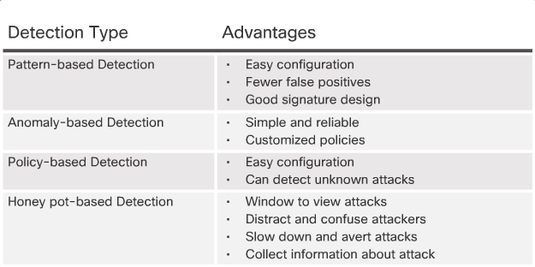
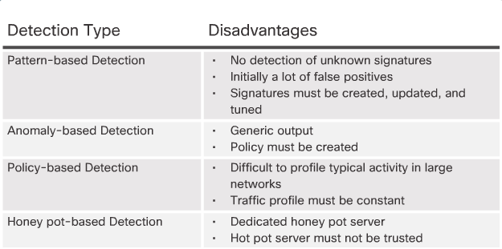
Signature Alarm
Notes:
5.2.2.1 Signature Alarm

Slide 30
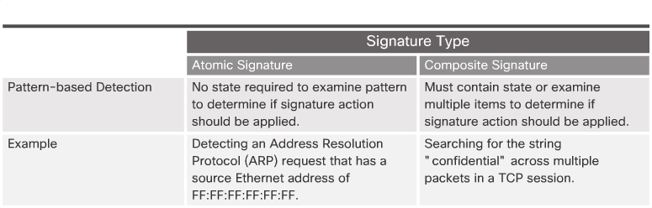
Pattern-Based Detection
Notes:
5.2.2.2 Pattern-Based Detection

Slide 31
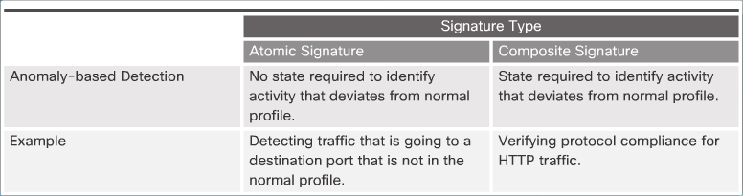
Anomaly-Based Detection
Notes:
5.2.2.3 Anomaly-Based Detection

Slide 32
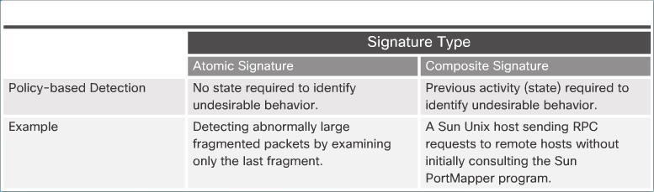
Policy-Based and Honey Pot-Based Detection
Honey pot-based detection uses a dummy server to attract attacks. The purpose of the honey pot approach is to distract attacks away from real network devices.
By staging different types of vulnerabilities in the honey pot server, administrators can analyze incoming types of attacks and malicious traffic patterns. They can then use this analysis to tune their sensor signatures to detect new types of malicious network traffic.
Honey pot systems are rarely used in production environments. Antivirus and other security vendors tend to use them for research.
Notes:
5.2.2.4 Policy-Based and Honey Pot-Based Detection

Slide 33
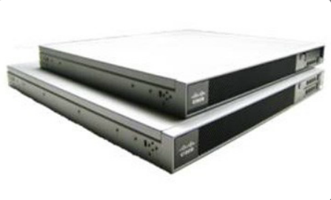
Benefits of the Cisco IOS IPS Solution
Benefits:
It uses underlying routing infrastructure to provide an additional layer of security.
It is inline and is supported on a broad range of routing platforms.
It provides threat protection at all entry points to the network when used in combination with Cisco IDS, Cisco IOS Firewall, VPN, and NAC solutions
The size of the signature database used by the devices can be adapted to the amount of available memory in the router.
Notes:
5.2.2.5 Benefits of the Cisco IOS IPS Solution

Slide 34
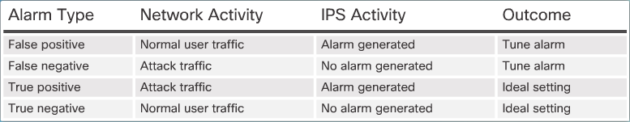
Alarm Triggering Mechanisms
Understanding Alarm Types:
False Positive
True Positive
Alarm Attack Traffic
Notes:
5.2.2.6 Alarm Triggering Mechanisms
5.2.2.7 Activity – IPS Signature Alarms

Slide 35
Topic 5.2.3: IPS Signature Actions

Slide 36
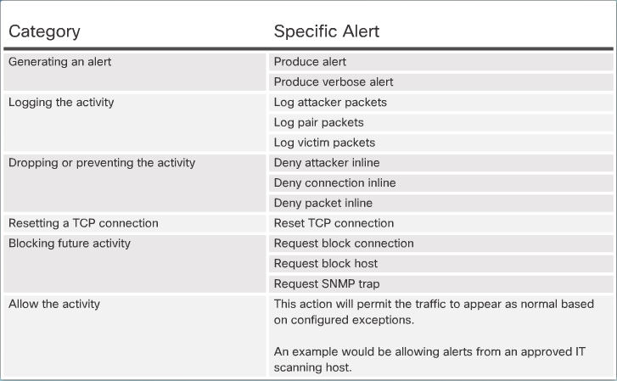
Signature Actions
Summary of Action Categories:
Notes:
5.2.3.1 Signature Actions
Verbose = using or expressed in more words than are needed.

Slide 37
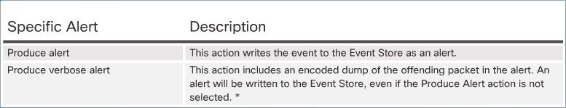
Manage Generated Alerts
Generating an Alert:
Notes:
5.2.3.2 Manage Generated Alerts

Slide 38
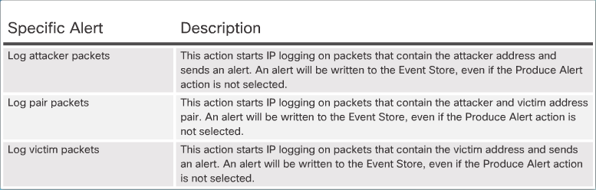
Log Activities for Later Analysis
Logging the Activity:
Notes:
5.2.3.3 Log Activities for Later Analysis

Slide 39
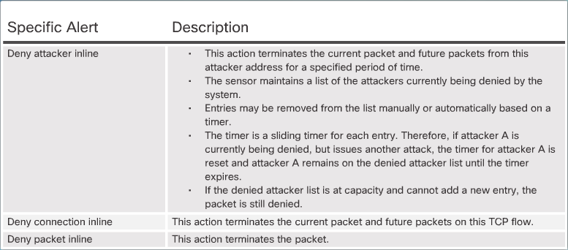
Deny the Activity
Dropping or Preventing the Activity:
Notes:
5.2.3.4 Deny the Activity

Slide 40
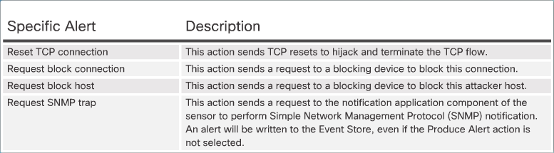
Reset, Block, and Allow Traffic
Resetting the Connection and Blocking the Activity:
Notes:
5.2.3.5 Reset, Block, and Allow Traffic
5.2.3.6 Activity – Identify the IPS Signature Action

Slide 41
Topic 5.2.4: Manage and Monitor IPS

Slide 42
Monitor Activity
IPS Planning and Monitoring Considerations:
Management method
Event correlation
Security staff
Incident response plan
Notes:
5.2.4.1 Monitor Activity

Slide 43
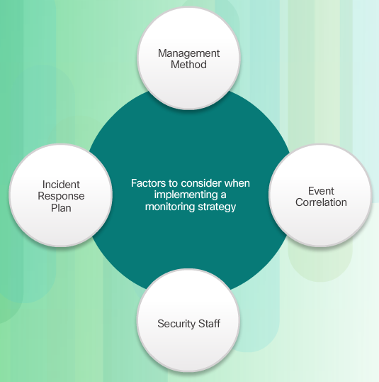
Monitoring Considerations
Notes:
5.2.4.2 Monitoring Considerations

Slide 44
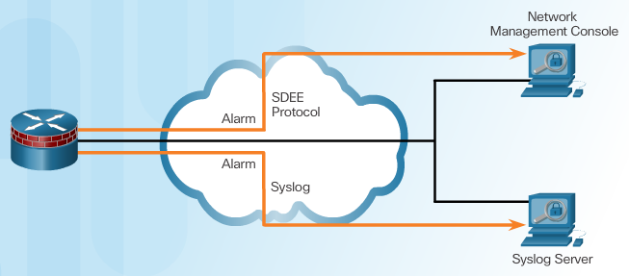
Secure Device Event Exchange
IPS sensors and Cisco IOS IPS generate alarms when an enabled signature is triggered. These alarms are stored on the sensor and can be viewed locally, or through a management application, such as IPS Manager Express.
When an attack signature is detected, the Cisco IOS IPS feature can send a syslog message or an alarm in Secure Device Event Exchange (SDEE) format, as shown in the figure.
Notes:
5.2.4.3 Secure Device Event Exchange

Slide 45
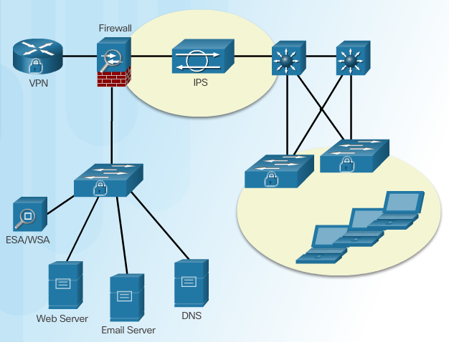
IPS Configuration Best Practices – refer to curicullum
Notes:
5.2.4.4 IPS Configuration Best Practices

Slide 46
Topic 5.2.5: IPS Global Correlation

Slide 47
Cisco Global Correlation
Goals of global correlation:
Dealing intelligently with alerts to improve effectiveness
Improving protection against known malicious sites
Sharing telemetry data with the SensorBase Network to improve visibility of alerts and sensor actions on a global scale
Simplifying configuration settings
Automatic handling of security information uploads and downloads
In addition to maintaining signature packs, Cisco IPS includes a security feature called Cisco Global Correlation. With global correlation, Cisco IPS devices receive regular threat updates from a centralized Cisco threat database called the Cisco SensorBase Network.
The Cisco SensorBase Network contains real-time, detailed information about known threats on the Internet. The goals of the Cisco Global Correlation are shown in the figure.
Notes:
5.2.5.1 Cisco Global Correlation

Slide 48
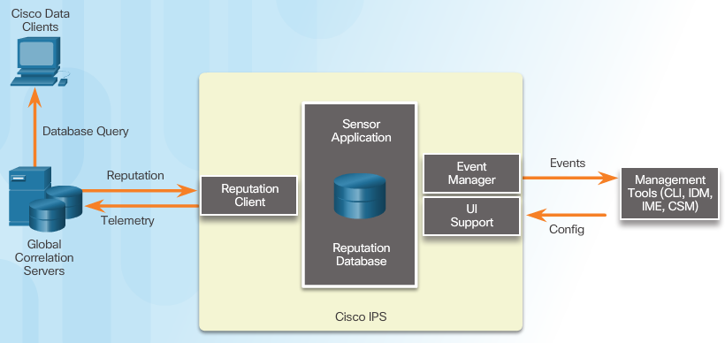
Cisco SensorBase Network
Notes:
5.2.5.2 Cisco SensorBase Network
Telemetry = the process of recording and transmitting the readings of an instrument.

Slide 49
Cisco Security Intelligence Operation
Network participation gathers the following data:
Signature ID
Attacker IP address
Attacker port
Maximum segment size
Victim IP address
Victim port
Signature version
TCP options string
Reputation score
Risk rating
Notes:
5.2.5.3 Cisco Security Intelligence Operation

Slide 50
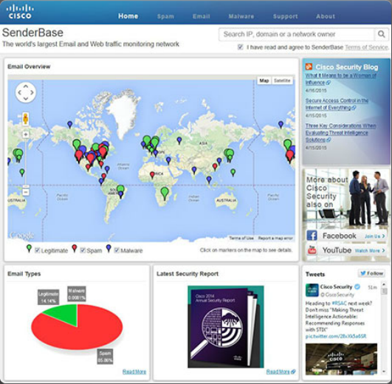
Reputations, Blacklists, and Traffic Filters
Notes:
5.2.5.4 Reputations, Blacklists, and Traffic Filters
5.2.5.5 Reputations, Blacklists, and Traffic Filters (Cont.)

Slide 51
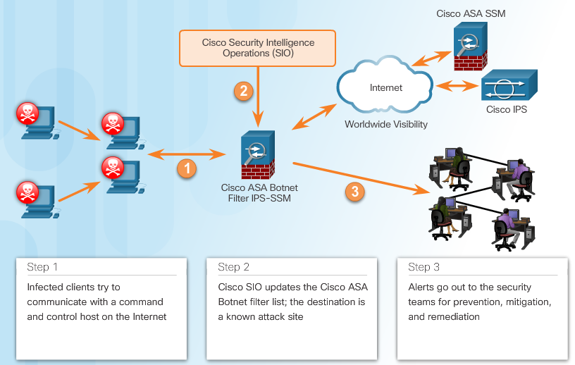
Reputations, Blacklists, and Traffic Filters
Notes:
5.2.5.4 Reputations, Blacklists, and Traffic Filters
5.2.5.5 Reputations, Blacklists, and Traffic Filters (Cont.)

Slide 52
Section 5.3: Implement IPS
Upon completion of this section, you should be able to:
Understand how to configure Cisco IOS IPS with CLI
Explain how to verify and monitor IPS

Slide 53
Topic 5.3.1: Configure Cisco IOS IPS with CLI

Slide 54
Implement IOS IPS
Step 1. Download the IOS IPS files.
Step 2. Create an IOS IPS configuration directory in Flash.
Step 3. Configure an IOS IPS crypto key.
Step 4. Enable IOS IPS.
Step 5. Load the IOS IPS signature package to the router.
Notes:
5.3.1.1 Implement IOS IPS

Slide 55
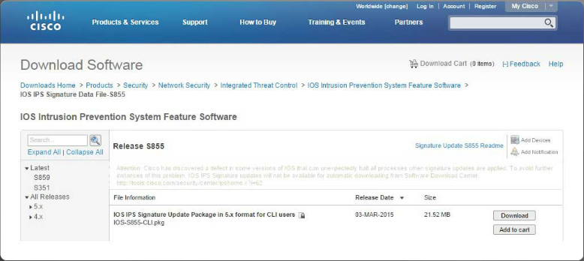
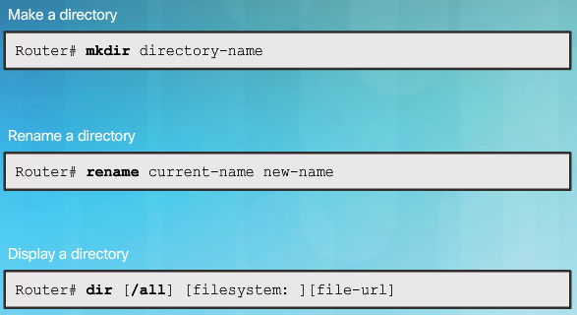
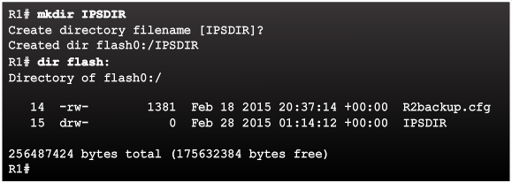
Download the IOS IPS Files
Notes:
5.3.1.2 Download the IOS IPS Files
5.3.1.3 IPS Crypto Key
5.3.1.4 Enable IOS IPS
5.3.1.5 Load the IPS Signature Package in RAM

Slide 56
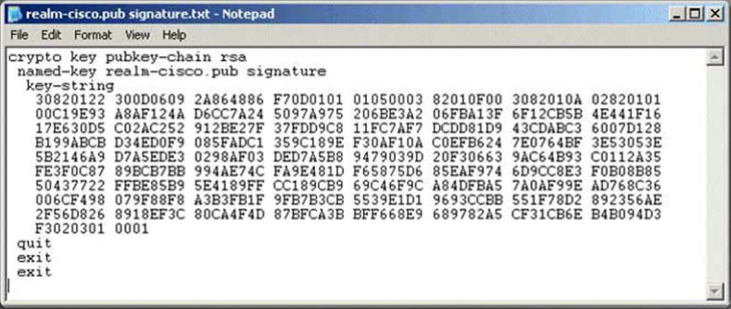
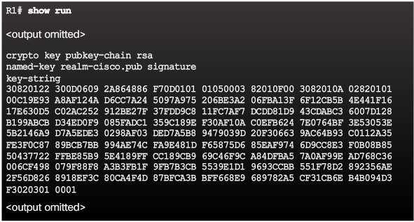
IPS Crypto Key
Notes:
Page 5.3.1.3

Slide 57
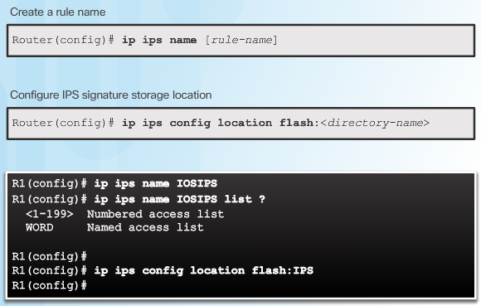
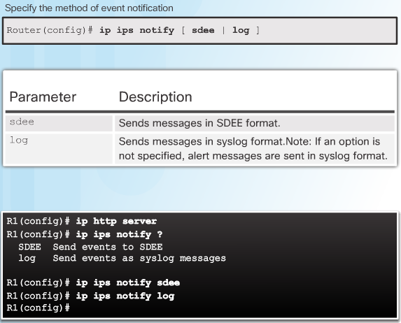
Enable IOS IPS
Notes:
Page 5.3.1.4

Slide 58
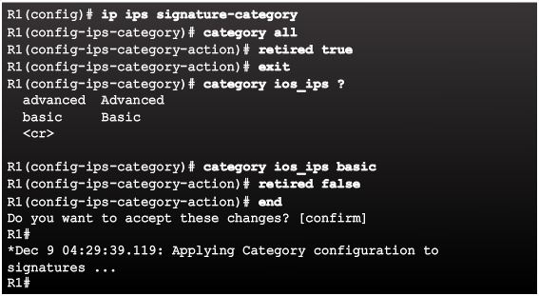
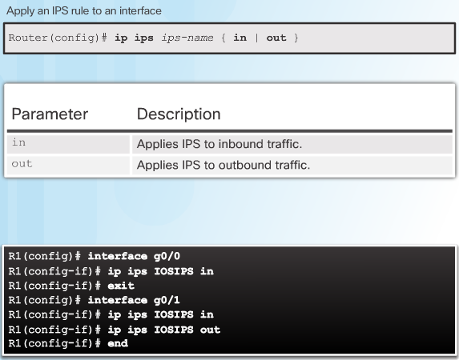
Enable IOS IPS
Notes:
Page 5.3.1.4 (cont.)

Slide 59
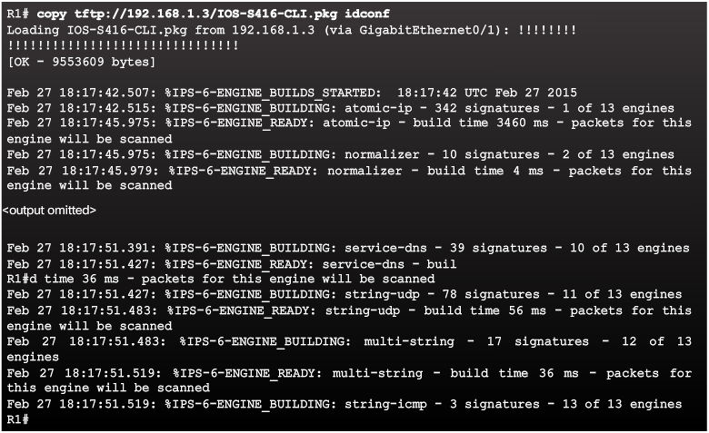
Load the IPS Signature Package in RAM
Notes:
5.3.1.5 Load the IPS Signature Package in RAM

Slide 60
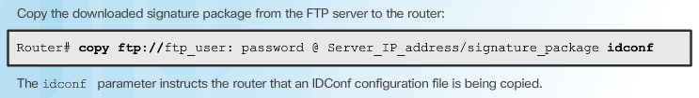
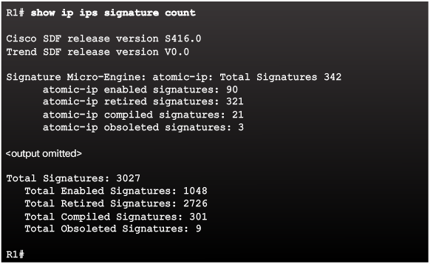
Load the IPS Signature Package in RAM
Notes:
5.3.1.5 Load the IPS Signature Package in RAM (Cont.)
5.3.1.6 Activity – Implementing IPS

Slide 61
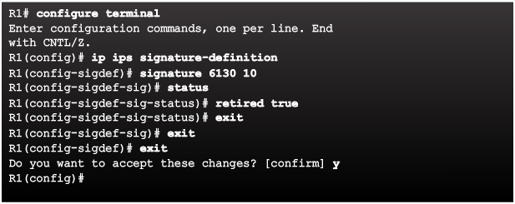
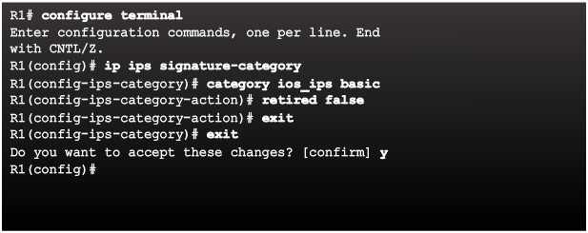
Retire and Unretire Signatures
Retiring an Individual Signature:
Retiring a Signature Category:
Notes:
5.3.2.1 Retire and Unretire Signatures

Slide 62
Topic 5.3.2: Modifying Cisco IOS IPS Signatures

Slide 63
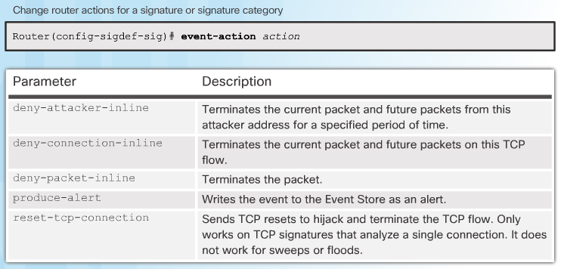
Change Signature Actions
Notes:
5.3.2.2 Change Signature Actions

Slide 64
Topic 5.3.3: Verify and Monitor IPS

Slide 65
Verify IOS IPS
Show commands to verify the IOS IPS configuration:
show ip ips
show ip ips all
show ip ips configuration
show ip ips interfaces
show ip ips signatures
show ip ips statistics
Clear commands to disable IPS:
clear ip ips configuration
clear ip ips statistics
Notes:
5.3.3.1 Verify IOS IPS

Slide 66
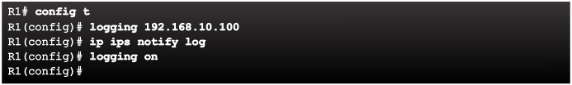
Report IPS Alerts
To specify the method of event notification, use the ip ips notify global configuration mode command. The log keyword sends messages in syslog format. The sdee keyword sends messages in SDEE format.
Notes:
5.3.3.2 Report IPS Alerts

Slide 67

Enable SDEE
Notes:
5.3.3.3 Enable SDEE

Slide 68
Section 5.4: Summary
Chapter Objectives:
Describe IPS technologies and how they are implemented.
Explain IPS Signatures.
Describe the IPS implementation process.
Notes:
5.4.1.1 Packet Tracer – Configure an IOS IPS Using CLI
5.4.1.2 Lab – Configure an IOS IPS Using CLI

Slide 70


Instructor Resources
Remember, there are helpful tutorials and user guides available via your NetSpace home page. (https://www.netacad.com)
These resources cover a variety of topics including navigation, assessments, and assignments.
A screenshot has been provided here highlighting the tutorials related to activating exams, managing assessments, and creating quizzes.
1
2
Notes:
https://www.netacad.com

